Slide 1

Javascript: Document Object Model (DOM)

Slide 2
Document Object Model
Document Object Model (DOM) - The most basic scripting interface which allows programs and scripts to dynamically access and update the content, structure and style of documents.
Modifications of the content using the DOM by the user and by scripts trigger events that developers can make use of to build rich user interfaces.

Slide 3
Document Object Model (DOM)
DOM converts HTML elements of the web page into JavaScript built-in objects
Each objects has predefined variables and methods that become available to JavaScript code
Every web page has the following objects:
Navigator : properties for name and version of the browser
Window : for the browser window and every frame of a set
Document : refers to the web page currently displayed
Location : contains the web page URL
History : has the previously requested URLs

Slide 4
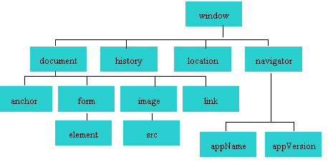
Document Object Model (DOM)
A portion of the DOM is shown at the left.
Defines every object and element on a web page
Hierarchical structure
Accesses page elements and apply styles to page elements

Slide 5
What is an object in DOM?
An object is a thing or entity.
Browser window
Submit button
Web page document

Slide 6
Document Object Model (DOM)
How do I access methods or properties?
To access methods or properties of these objects you must use the dot (.) notation
Example:
window.history //accesses the history object
window.location //accesses the location object

Slide 7
Property
A property is a characteristic or attribute of an object.
The background color of a web page document document.bgcolor
The date the web page file was last modified document.lastmodified
The src file of an image object
image1.src

Slide 8
Method
A method is an action (a verb)
Writing text to a web page document
document.write()
Submitting a form
form.submit()

Slide 9
Document Object
document is a popular JavaScript object
Properties of this object:
alinkcolor, anchors[], applets[], bgcolor, cookie, domain, embeds[], fgcolor, forms[], images[], lastModified, linkColor, links[], location, plugins, referrer, title, URL, vlinkColor
Methods of this object:
clear(), close(), open(), write(), writeln()

Slide 10
Document Object
Screen is initially white and then is changed to black
<script type="text/javascript"> alert("Change in colour"); document.bgColor = "#fff";
</script>
<script type="text/javascript">
document.write("Hello World!");
</script>
Hello World!

Slide 11
Document Object
<a name="first">First anchor</a><br />
<a name="second">Second anchor</a><br />
<a name="third">Third anchor</a><br />
<br />
Number of anchors in this document:
<script type="text/javascript">
document.write(document.anchors.length);
</script>
First anchor Second anchor Third anchor Number of anchors in this document: 3

Slide 12
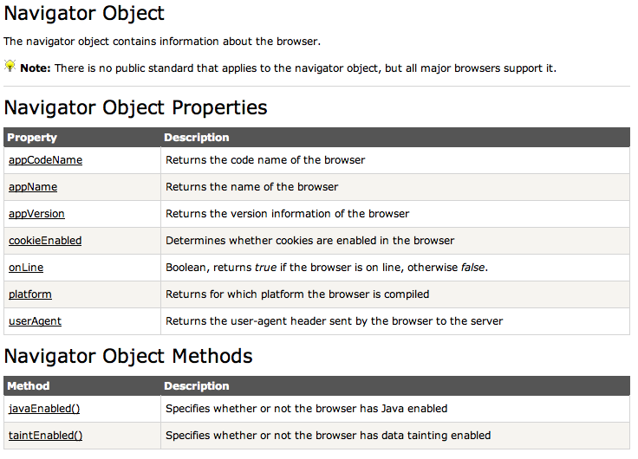
Navigator Object

Slide 13
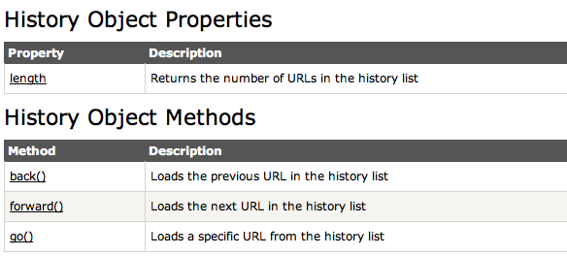
History Object

Slide 14
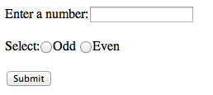
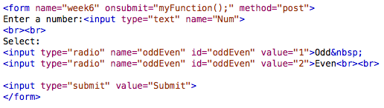
Form Object: Validating Form Information

Slide 15
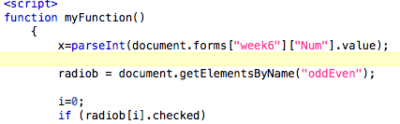

Validating Form Information
Where did I get this from?

Slide 16

Validating Form Information
Where did I get this from?

Slide 17
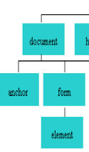
Validating Form Information
So what does this mean?
document.forms["week6"]["Num"].value
Value in form
element
Name of form
element
Name of form

Slide 18
Validating Form Information
So what does this mean?
document.forms["week6"]["Num"].value

Slide 19
Validating Form Information
Form elements can be accessed in different ways
Another example:

Slide 20
Validating Form Information
Information received from a radio button can also be accessed as follows:
radiob = document.forms["week6"]["oddEven"];
radiob = document.forms[0]["oddEven"];
radiob = document.week6.oddEven;
…..

Slide 21
Another useful DOM attribute
Another option for output:
document.getElementById(’myParagraph').innerHTML=”I love DOM";
<div id = “myParagraph”>I hate DOM</div>
When associated with an event handler the output will change from
“I hate DOM” to
“I love DOM”

Slide 22
Useful DOM functions: getElementBy…

Slide 23
getElementById() or getElementsByName
document.getElementById(“..”)
OR
document.getElementsByName(“..”)
Document Object
document.getElementById(“..”)
document.getElementsByName(“..”)

Slide 24
getElementById()
This method is one of the most common methods in the HTML DOM, and is used almost every time you want to manipulate, or get info from an element on your document.

Slide 25
getElementById()
Get the element with the specified ID - demo:
var x = document.getElementById("demo");
x.style.color = "red"; //Change the colour of the layer called demo to red

Slide 26
getElementById()
document.getElementById("demo").innerHTML = "Hello JavaScript";
document.getElementById("demo").style.fontSize = "25px";

Slide 27
getElementsByName()
The getElementsByName() method returns a collection of all elements in the document with the specified name (the value of the name attribute), as a NodeList object.

Slide 28
getElementsByName()
Gets all elements with the specified name - demo:
var x = document.getElementsByName("fname");
var x = document.getElementsByName("animal").length;

Slide 29
Exercise 3: Using DOM
Set the date in the footer of the webpage that updates when the page is loaded:
Create the function
Create a new layer in the footer – “demo”
Retrieve the information from the Date object
Put the date into “demo”

Slide 30
Exercise 4: Using DOM
Using DOM, create a button in the footer so that when clicked the background colours of the colour will change.

Slide 31
Why use External JavaScript?
Placing JavaScript in external files has some advantages:
It separates HTML and code
It makes HTML and JavaScript easier to read and maintain
Cached JavaScript files can speed up page loads

Slide 32
How do I use External JavaScript?
Place your JavaScript in a text file and call it something.js. All JS files have a .js extension.
Place the following piece of code in your HTML file (at the end, where possible):
<script src=”something.js"></script>

Slide 33
Exercise 5: Using External JavaScript
Put all javascript code into an external file and link to this external file in the HTML file

Slide 34
JavaScript Frameworks

Slide 35
JavaScript Frameworks
Advanced JavaScript programming can often be very difficult and time-consuming to work with.
To deal with these difficulties, a lot of JavaScript (helper) libraries have been developed.
These JavaScript libraries are often called JavaScript frameworks.

Slide 36
Examples of JavaScript Libraries/Frameworks
Mootools
Jquery
Dojo
React
..

